Slide 1
Telecom PR Automation - User Flow Guide

Slide 2
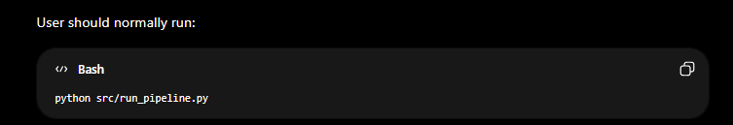
Main Entry Point
run_pipeline.py
This is the master script.
User should normally run:

Slide 3

This script should execute the complete workflow:
BOM.xlsx
+
EPMS.xlsx
↓
Normalize Data
↓
Calculate Quantities
↓
Generate PR Lines
↓
Generate General Items
↓
Merge PR + General Items
↓
Generate ECC Output Excel

Slide 4
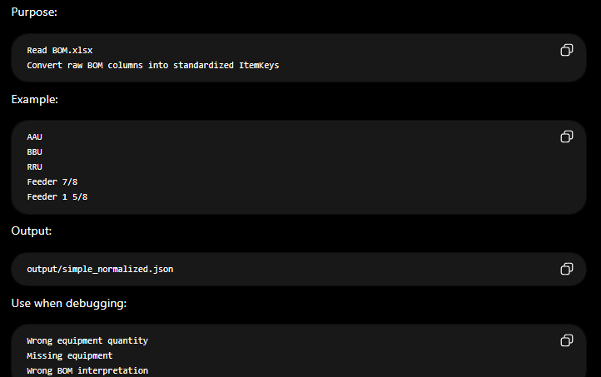
Step 1:simple_normalize.py

Slide 5
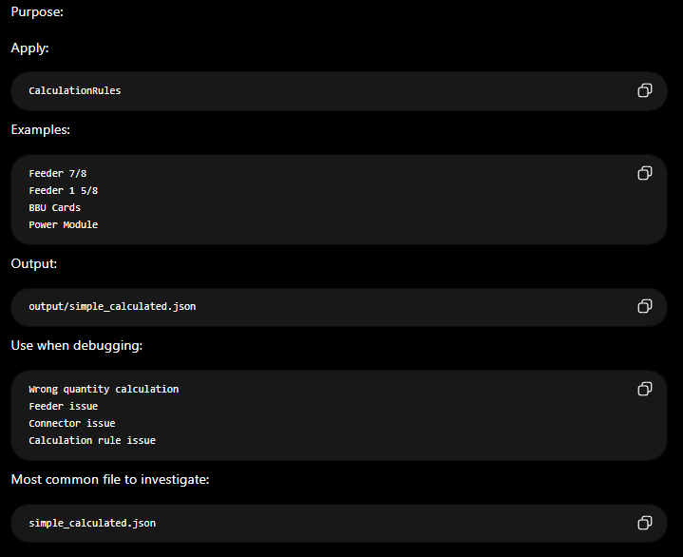
Step 2:simple_calculation.py

Slide 6
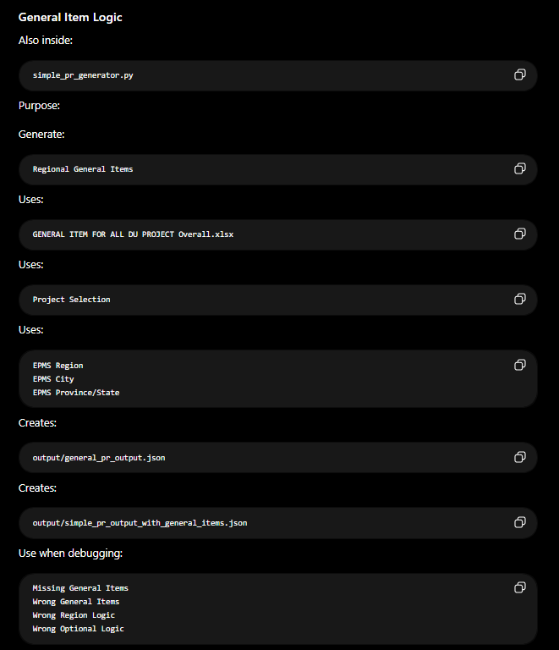
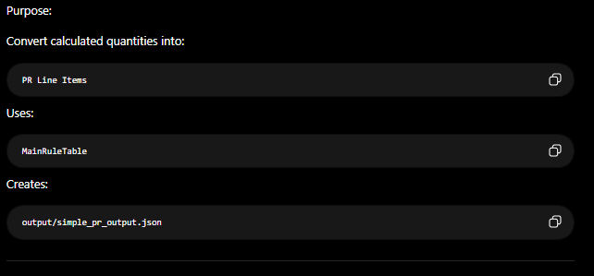
Step 3:simple_pr_generator.py

Slide 7
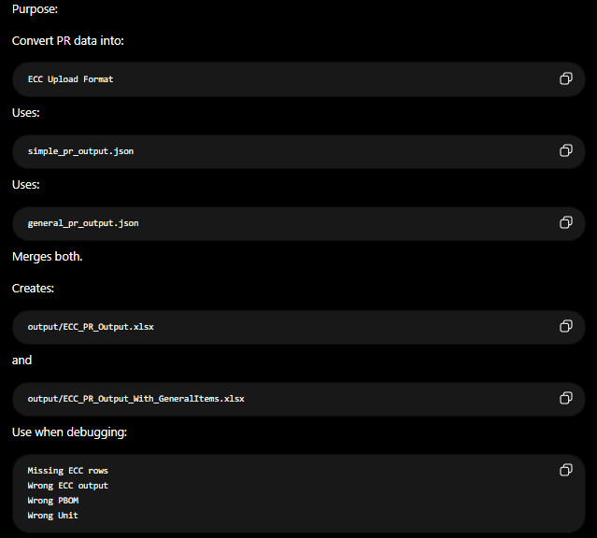
Step 4:simple_ecc_export.py

Slide 8
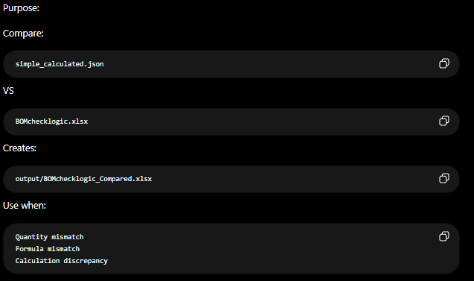
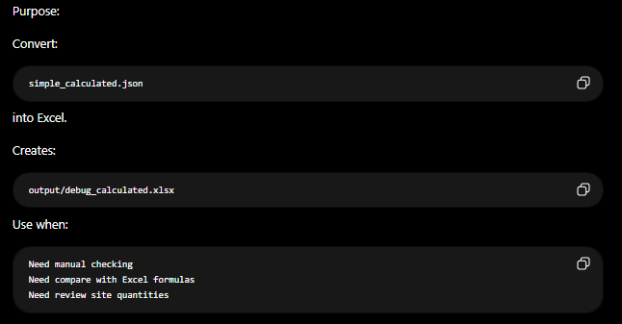
Debug Tools
debug_compare_bom_logic.py
debug_export_calculated_excel.py

Slide 9
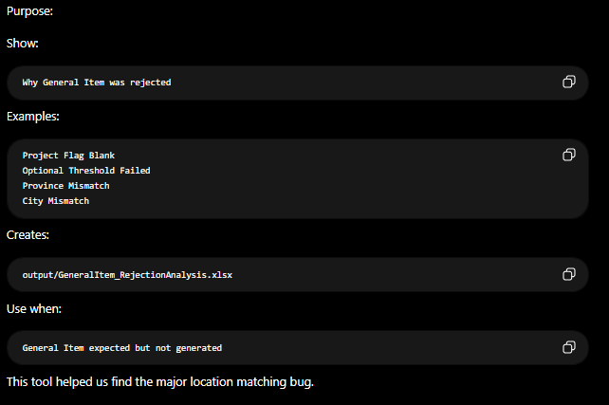
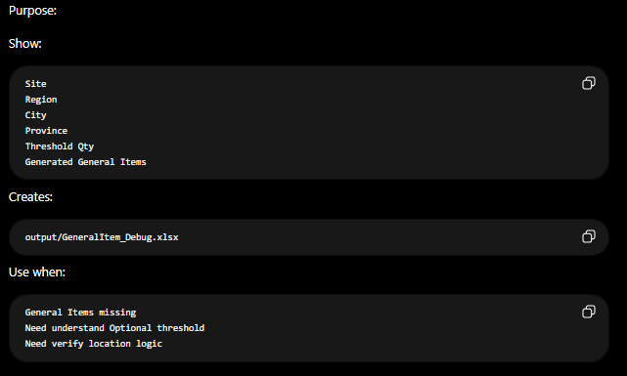
Debug Tools
debug_general_item_rejection_analysis.py
debug_general_item_analysis.py

Slide 10
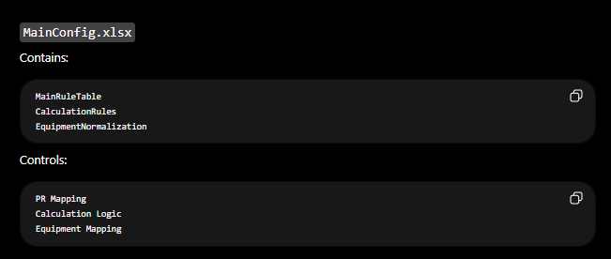
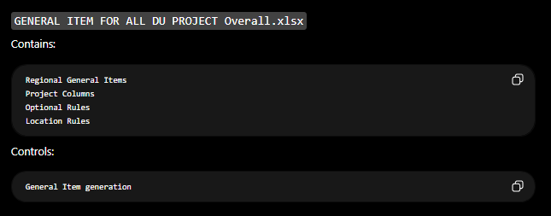
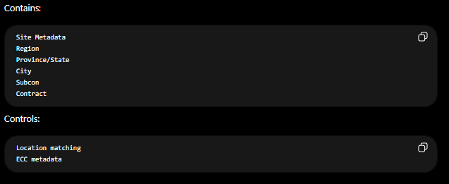
Configuration Files
MainConfig.xlsx
GENERAL ITEM FOR ALL DU PROJECT Overall.xlsx
EPMS.xlsx

Slide 11
Troubleshooting Quick Reference
Problem | Check First
Wrong Equipment Qty | simple_normalized.json
Wrong Feeder Qty | simple_calculated.json
Wrong BBU Cards | CalculationRules
Missing PR Item | simple_pr_output.json
Missing General Item | general_pr_output.json
Wrong Location General Item | GeneralItem_RejectionAnalysis.xlsx
Wrong PBOM | MainRuleTable
Wrong Unit | MainRuleTable Column J
Missing ECC Line | simple_ecc_export.py
ECC Output Wrong | ECC_PR_Output_With_GeneralItems.xlsx

Slide 12
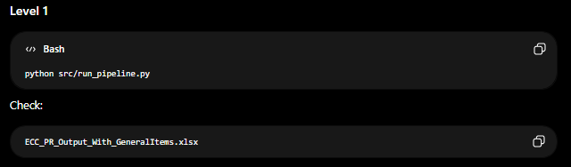
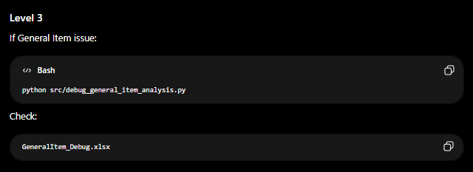
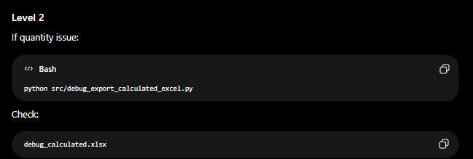
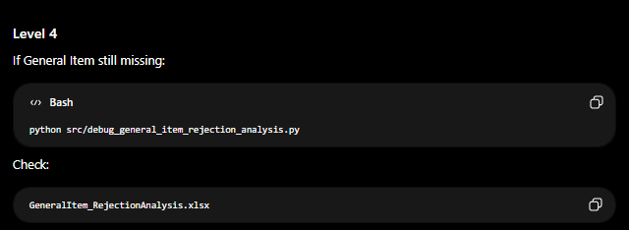
Recommended User Testing Flow

Slide 13
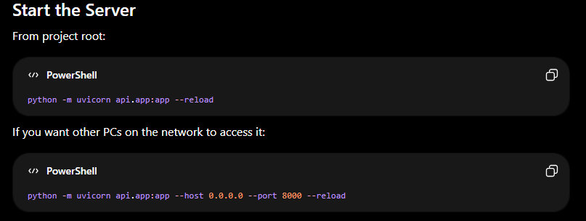
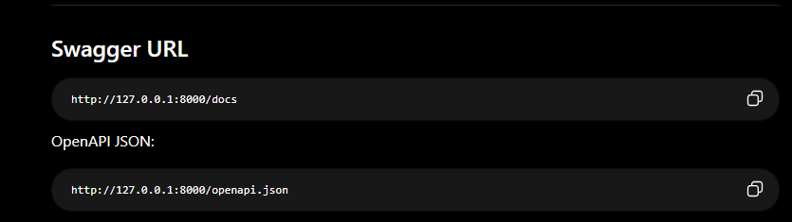
python -m uvicorn api.app:app --reload
python -m uvicorn api.app:app --host 0.0.0.0 --port 8000 --reload
http://127.0.0.1:8000/docs
http://127.0.0.1:8000/openapi.json

Slide 14
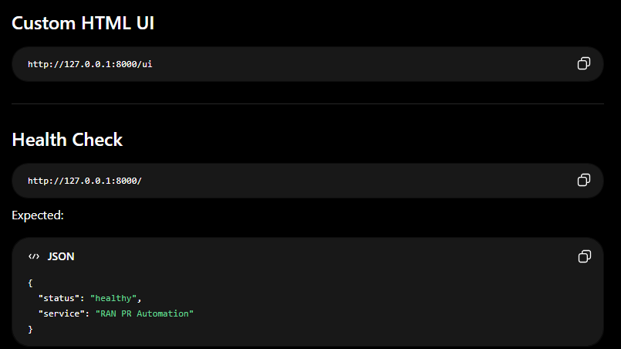
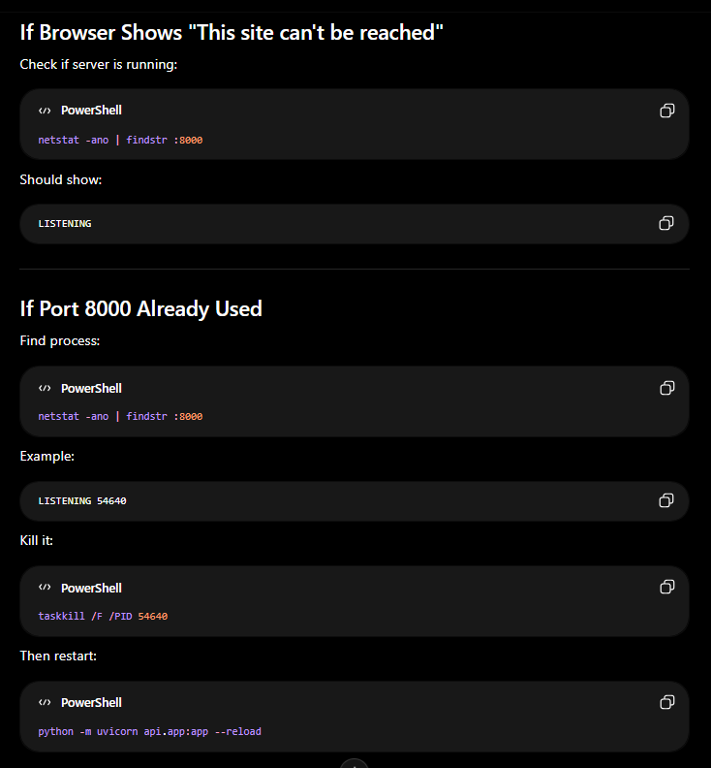
http://127.0.0.1:8000/ui
http://127.0.0.1:8000/
netstat -ano | findstr :8000
netstat -ano | findstr :8000
taskkill /F /PID 54640
python -m uvicorn api.app:app --reload

Slide 15
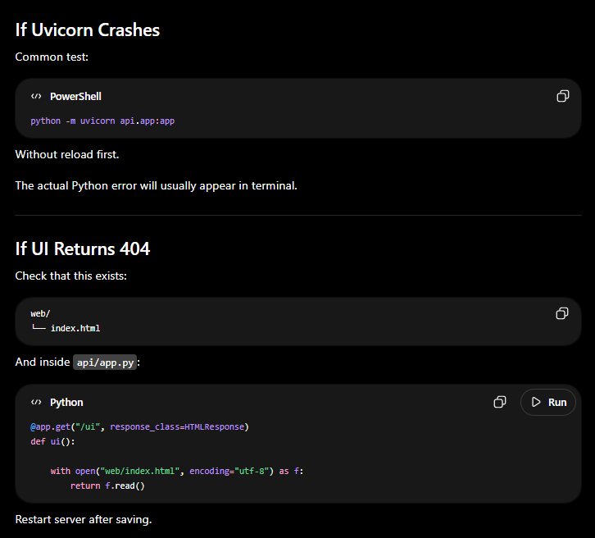
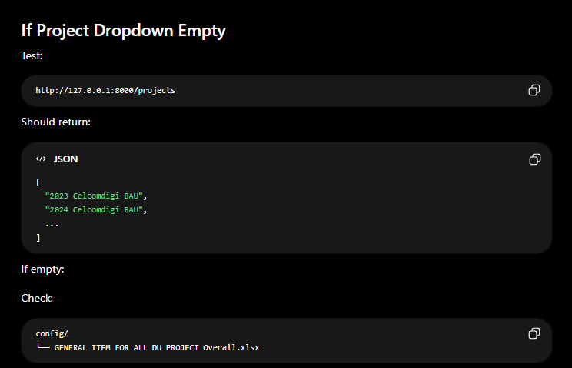
python -m uvicorn api.app:app
http://127.0.0.1:8000/projects

Slide 16
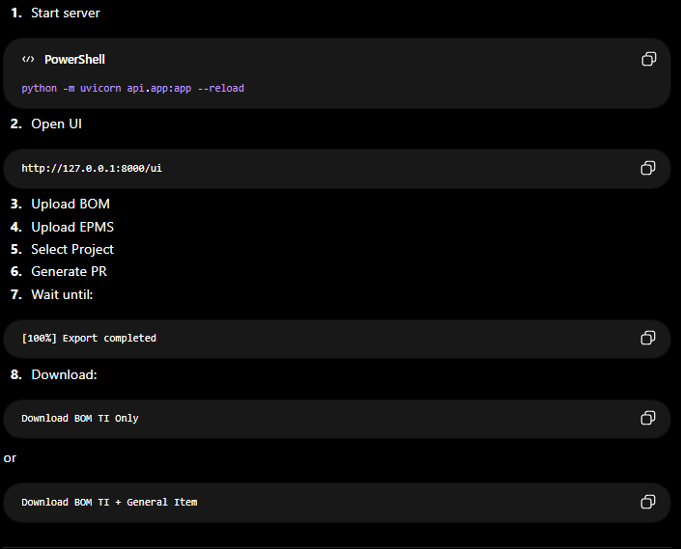
Full Daily Workflow
python -m uvicorn api.app:app --reload
http://127.0.0.1:8000/ui

Slide 17
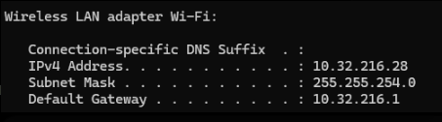
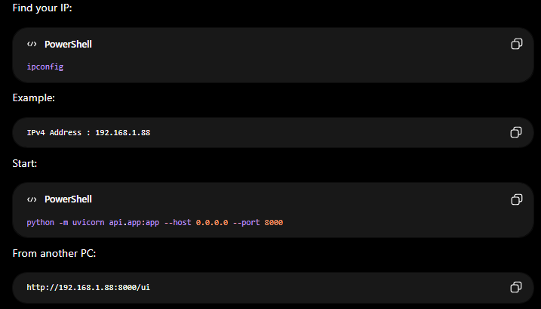
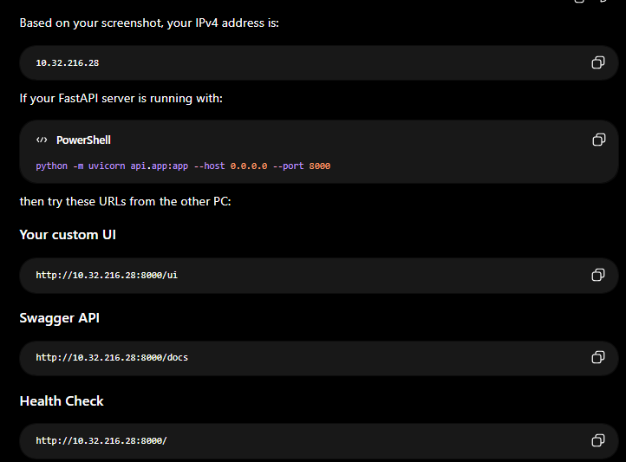
Network Access (Another PC)

